Slide 1
Project Presentation of Co-Op Project Industry (Module-2)
on
AI-Based Musculoskeletal Disorder Detection
Dheeraj Sharma 2210991503
Kapil Tanwar 2210991745
Supervised by:-
Simarjit Kaur
Department of Computer Science and Engineering,
Chitkara University, Punjab

Slide 2
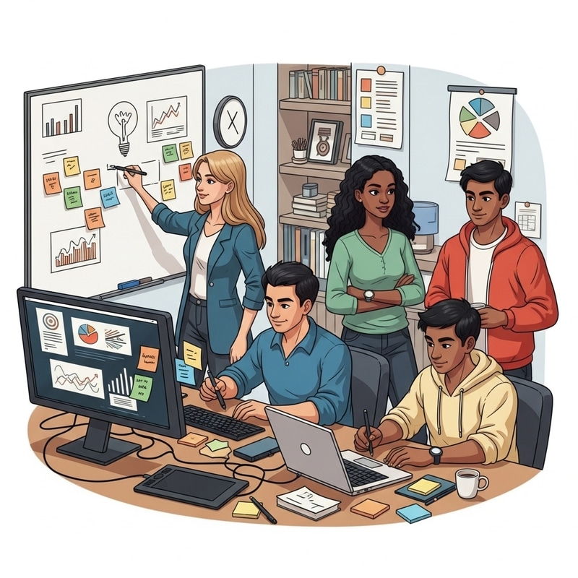
Content
1) Introduction to AI-Based Musculoskeletal Disorder Detection
2) System Overview and Functional Responsibilities
3) User Interface and Web-Based Interaction Module
4) Data Acquisition and Preprocessing Techniques
5) Technology Stack and Tools Used
6) Model Development and Implementation Details
7) Results, Performance Analysis, and Key Findings
8) Research Methodology and Workflow
9) Conclusion and Future Enhancements
10) Snapshots

Slide 3
Introduction
Musculoskeletal disorders (MSDs) affect muscles, joints, and bones, causing pain and reduced mobility. These disorders are increasingly common due to poor posture, long screen time, and lack of physical activity. Traditional diagnosis methods require physical visits to healthcare professionals and expensive equipment, which limits early detection.
To overcome these challenges, this research proposes an AI-based system that uses computer vision and deep learning techniques to automatically detect posture-related abnormalities. The system analyzes images or radiographic data and provides real-time detection along with personalized exercise recommendations. This approach aims to make healthcare more accessible, affordable, and efficient.
‹#›

Slide 4
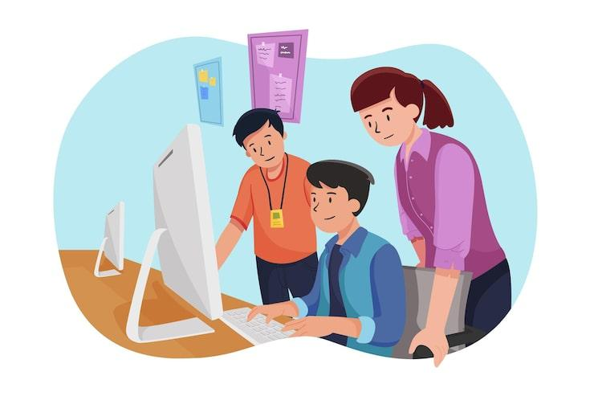
System Overview and Architecture Design
The proposed system follows a modular and layered architecture designed to process input data efficiently and generate accurate outputs. The architecture includes multiple components such as data acquisition, preprocessing, feature extraction, classification, decision fusion, and recommendation generation.
As shown in the architecture diagram, the system first collects image data, processes it, and then applies machine learning and deep learning models to detect abnormalities. The system integrates multiple models to improve accuracy and combines their outputs to produce a final diagnosis. This structured design ensures scalability, reliability, and real-time performance.
‹#›

Slide 5
User Interface and Web-Based Interaction Module
The system provides a user-friendly web interface that allows users to upload images for analysis. Once the image is uploaded, the system processes it and displays the results, including detected disorder, affected body part, confidence score, and recommended exercises.
The interface is simple and interactive, making it accessible even to non-technical users. The output is presented in a clear format, including visual reports and exercise guidance. This module plays a crucial role in improving user experience and ensuring practical usability of the system.

Slide 6

Data Acquisition and Preprocessing Techniques
The system uses datasets such as the MURA radiographic dataset and EMG dataset for training and evaluation. These datasets contain labeled images and signals representing normal and abnormal conditions.
Before feeding the data into models, preprocessing steps are applied. These include resizing images, converting them to grayscale, normalizing pixel values, and extracting feature vectors. Data augmentation techniques like rotation and noise addition are also used to improve model generalization. These steps ensure consistency, reduce noise, and enhance the performance of machine learning models.
‹#›

Slide 7
Technology Stack and Tools Used
The system is built using a combination of modern tools and technologies. Libraries such as OpenCV and NumPy are used for image processing and data manipulation. Machine learning and deep learning frameworks like TensorFlow are used to build and train models.
Various algorithms are implemented, including Logistic Regression, Random Forest, Decision Tree, KNN, and advanced deep learning models such as CNN, VGG, ResNet, and DenseNet. These technologies enable efficient data processing, accurate prediction, and scalable system development.
‹#›

Slide 8
Model Development and Implementation Details
The system uses both traditional machine learning models and deep learning architectures for classification tasks. Separate models are trained for body part identification and disorder detection.
During implementation, data is split into training and testing sets. Models are trained using feature vectors and evaluated based on performance metrics. Deep learning models automatically learn complex patterns from image data, making them more effective in detecting abnormalities.
The best-performing models are selected and saved for deployment. This hybrid approach improves accuracy and ensures reliable predictions.

Slide 9
Results, Performance Analysis, and Key Findings
The system demonstrates high accuracy in detecting musculoskeletal disorders. Performance is evaluated using metrics such as accuracy, precision, recall, F1-score, and ROC-AUC.
As shown in the confusion matrix, most predictions are correct with minimal errors. The training and validation graphs also indicate strong model performance with low overfitting. Deep learning models like DenseNet and ResNet outperform traditional models in classification tasks.
Additionally, the system successfully provides real-time predictions and personalized exercise recommendations, making it both a diagnostic and assistive tool.

Slide 10
Research Methodology and Workflow
The methodology of the system follows a structured workflow:
Data acquisition from datasets
Image preprocessing and feature extraction
Model training using ML and DL algorithms
Model evaluation using performance metrics
Prediction and disorder detection
Exercise recommendation generation
Output visualization and reporting
This step-by-step approach ensures systematic development and accurate results. The workflow integrates multiple stages into a single pipeline, making the system efficient and easy to use.

Slide 11
Conclusion and Future Enhancements
The proposed system successfully demonstrates the use of artificial intelligence for detecting musculoskeletal disorders and providing personalized exercise recommendations. It reduces dependency on manual diagnosis and enables early detection of posture-related issues.
The system is efficient, scalable, and user-friendly, making it suitable for real-world healthcare applications. However, there are some limitations, such as dependency on image quality and environmental conditions.
Future improvements may include expanding the dataset, integrating wearable devices, improving personalization using patient-specific data, and deploying the system as a mobile or cloud-based application. These enhancements can further improve accuracy and usability.

Slide 12
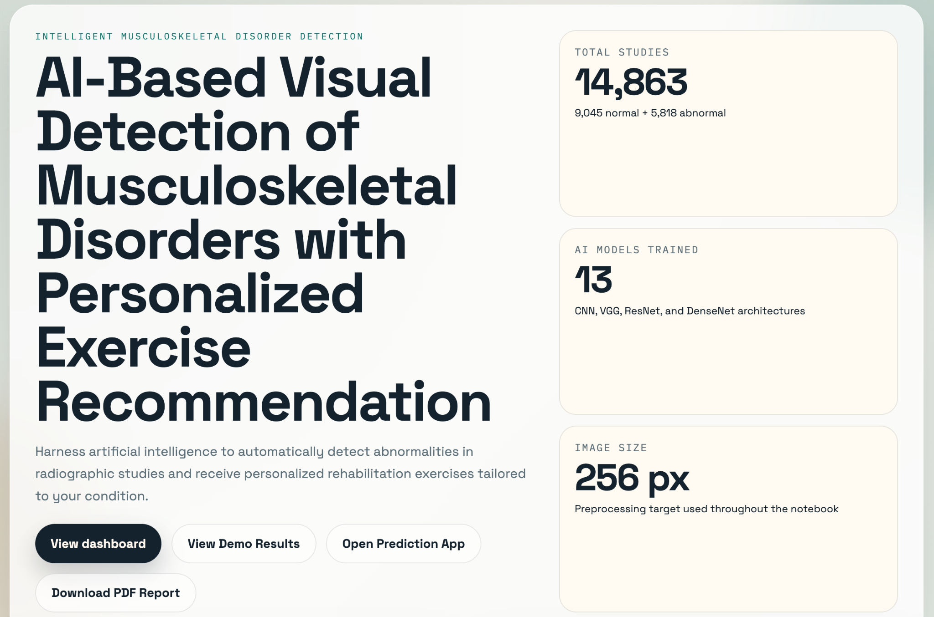
SnapShots

Slide 13
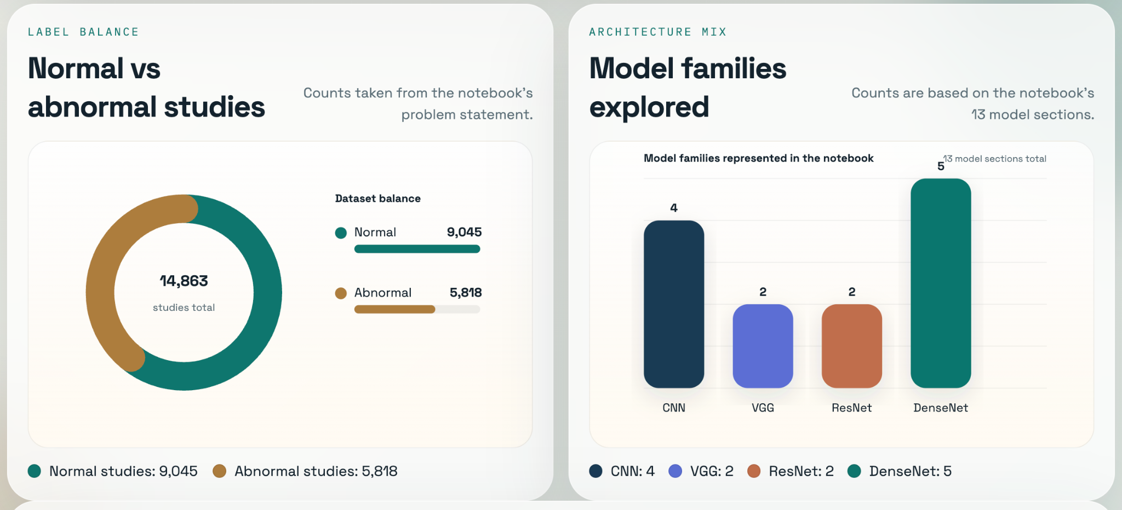
Snapshots

Slide 14
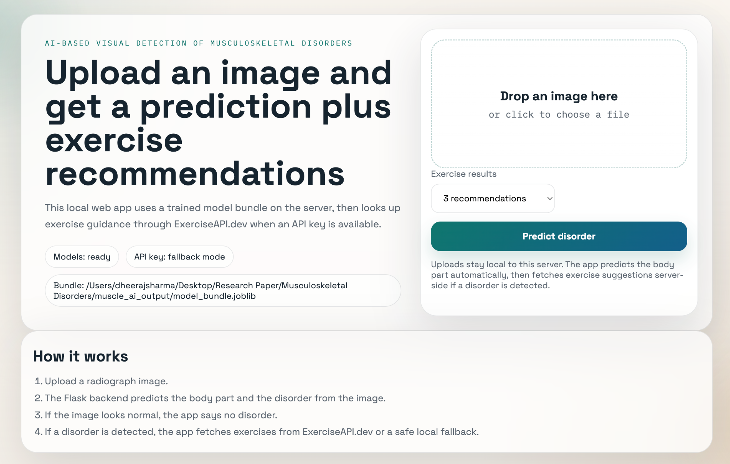
Snapshots

Slide 15

Conclusion
Thank you for your attention. I would be pleased to address any questions you may have.
‹#›

